Slide 1
Thrive Mart Case Study for E-Commerce App
Muhammad Daniyal Khan

Slide 2
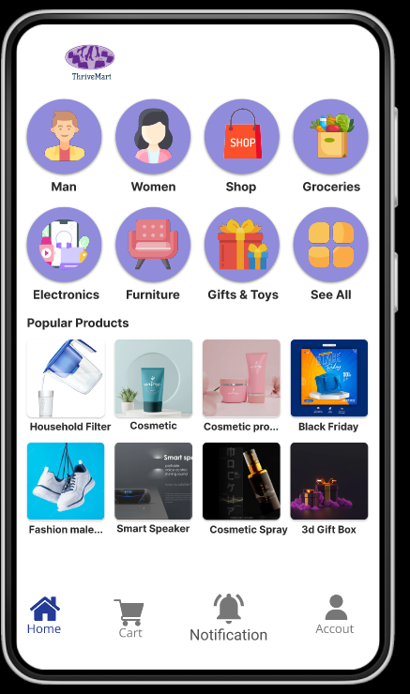

Project overview
The product:
Thrive mart is a contemporary super market located in a bustling area. Thrive mart is the biggest retail chain storming in business with massive sales. Thrive mart is providing a one-stop solution that offers, 52000+ products, holding 10,000+ brands along with the best prices and promotional deals for its customer.
Project duration:
March 2023 to May 2023.

Slide 3
Project overview
The problem:
People cannot go to physical market because of there bust routines
The goal:
Create a simple user-friendly e-commerce app for the super market so that customers can buy their preferred items from the comfort of their homes and have their orders delivered right to their doorstep

Slide 4
Project overview
My role:
Lead UX designer & UX researcher in creating app for Thrive Mart Super Market.
Responsibilities:
User research, conducting interviews, wireframing, low and high-ﬁdelity prototyping, design iterations, and ensuring accessibility.

Slide 5
Understanding
the user
User research
Personas
Story Boarding (Big Picture, Close Up)

Slide 6


User research: summary
Through the use of interviews and empathy maps I was able to understand who Thrive Mart App’s users are and to design to accommodate to their needs. Through research outcomes, I learned that a primary user group was composed of working adults passionate about shopping are, but could not go to buy things in Market .
With the research conducted, I learned that a large contributing factor for users not being able to physically go for shopping in Markets were busy schedules due to work or other obligations.

Slide 7
User research: pain points
1
2
Time
Location
Working adults do not have time to buy things from market.
People interested in purchasing household items may be limited how closely they live to the Mart

Slide 8
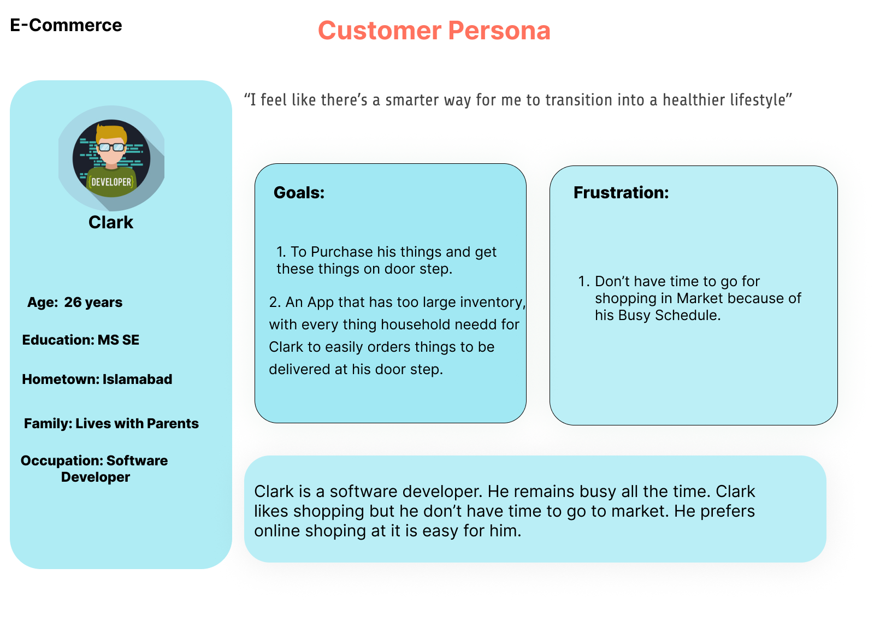

Slide 9
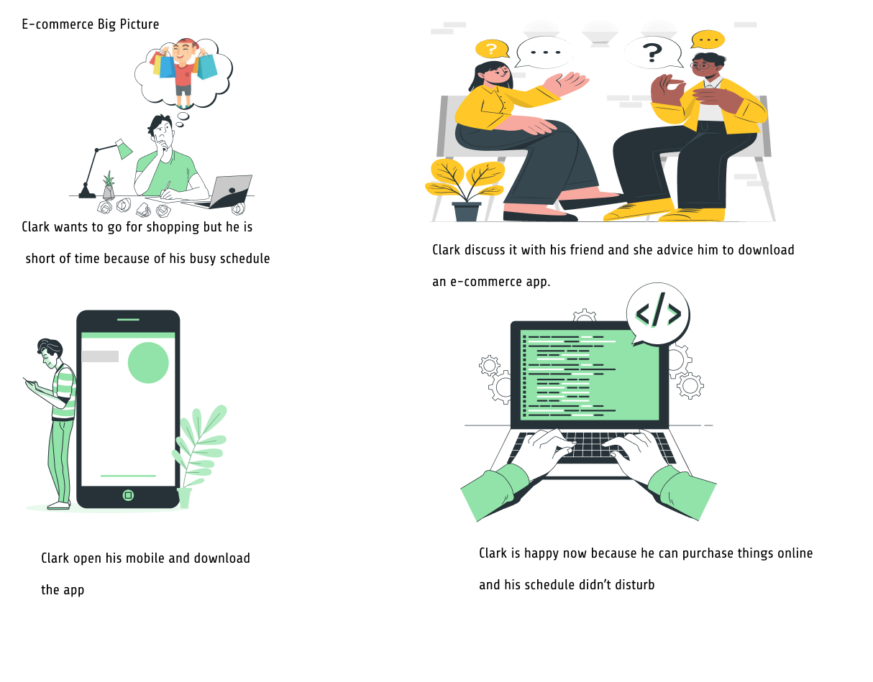
Big Picture

Slide 10
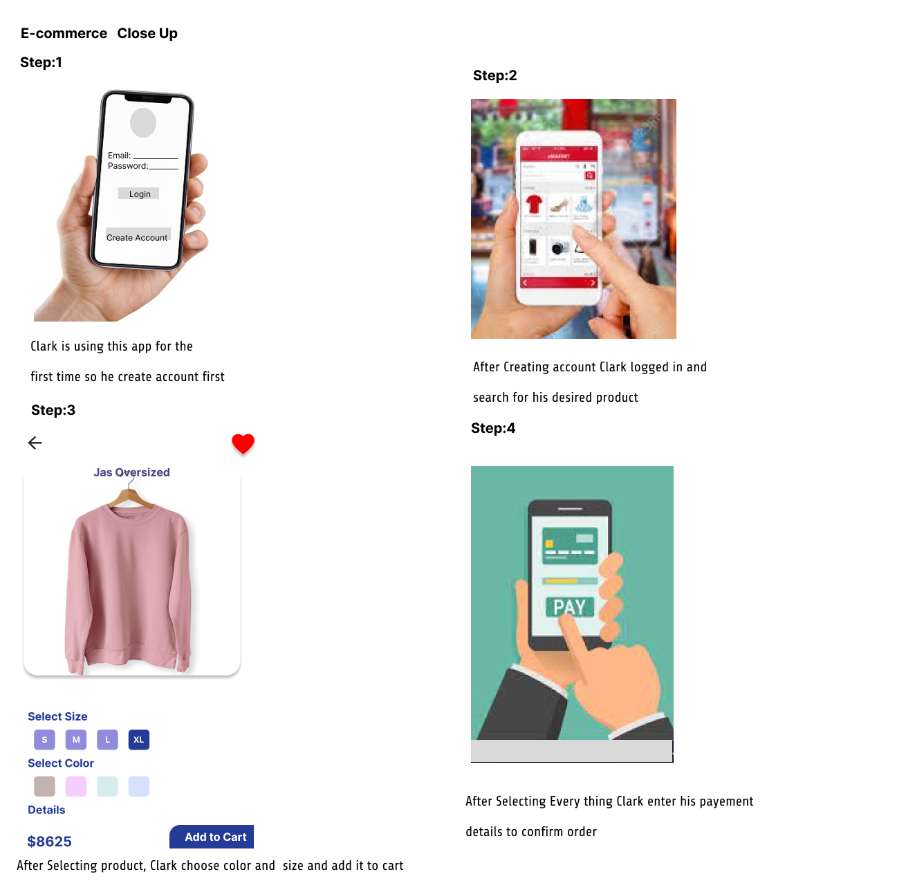
Close Up

Slide 11
Paper wireframes
Digital wireframes
Low-ﬁdelity prototype
Medium-fidelity prototype
Usability studies
Starting the design

Slide 12
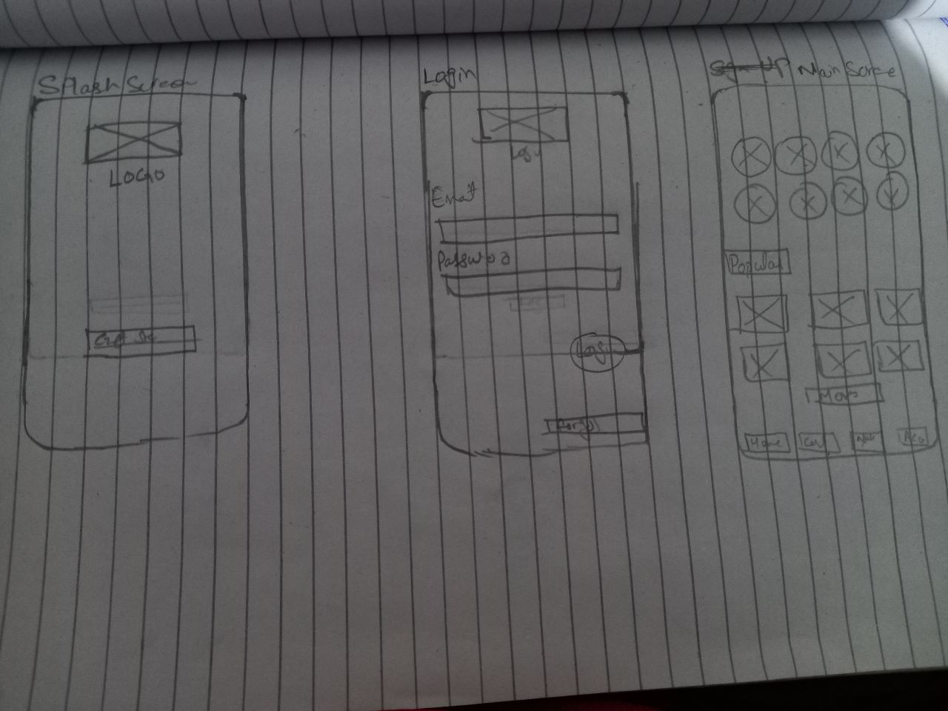
Paper wireframes
By drawing up the paper wireframes, it allowed me to eﬀectively organize best possible layouts for the app. I made it a priority for the app to maintain a clean and simple aesthetic.

Slide 13
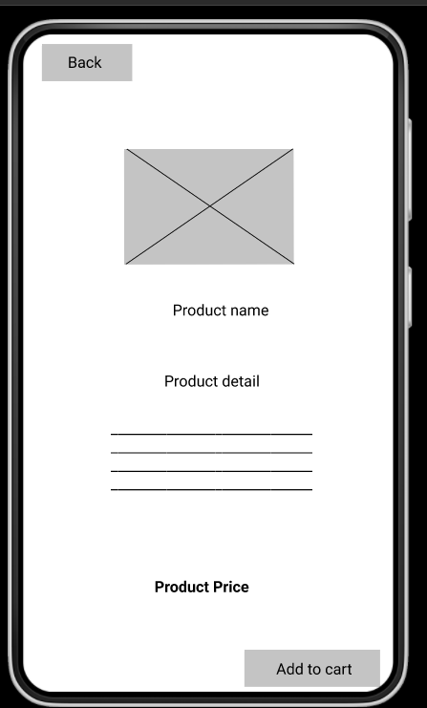
Digital wireframes
Through research, I learned that clean and simple design was much appreciated for optimal navigation and to avoid user confusion.
This button is clear in directing its users to add items in cart

Slide 14
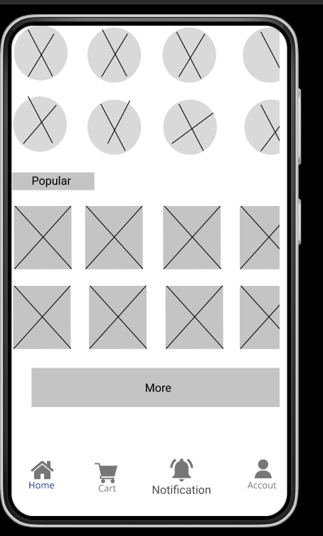
Digital wireframes
Bottom Navigation bar can help user to go from 1 screen to another easily. If a user is at account screen and want to go back to main screen then he can easily go back just with one click
Bottom Navigation Bar

Slide 15
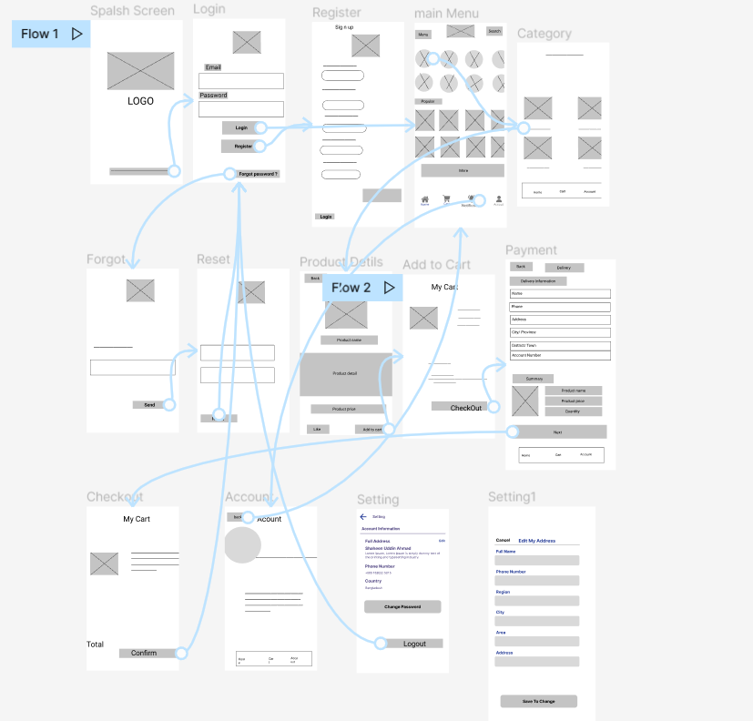
Low-Fidelity prototype
Low-ﬁdelity prototype allowed users to be observed via usability study by completing the main action of placing a bid on an art piece.
View the Thrive Mart Lo-ﬁ Prototype

Slide 16
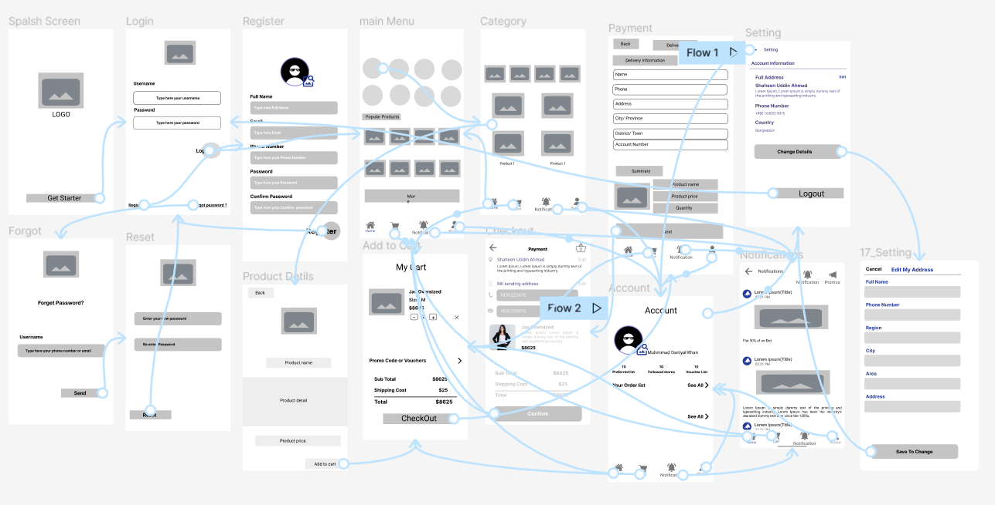
Medium-Fidelity prototype
Medium-fidelity prototypes are more detailed and closer to the final product compared to low-fidelity prototypes, which are usually rough sketches or basic wireframes. However, they are less polished and less time-consuming to create than high-fidelity prototypes, which closely resemble the final product in terms of appearance and functionality.
View the Thrive Mart Lo-ﬁ Prototype

Slide 17
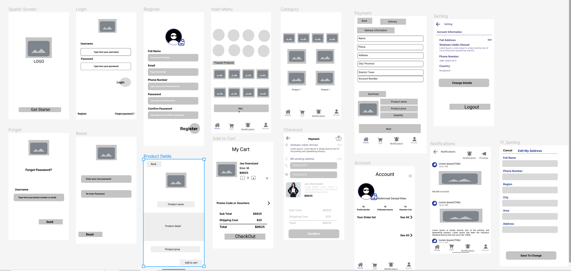
Medium-Fidelity prototype

Slide 18
Usability study: FIndings
Through the two usability studies that I conducted, a few ﬁndings stuck out to help make decisions in the design of the art auction app. The ﬁrst usability study helped my process in taking the wireframes to mockups. The second usability study guided me in making small tweaks to improve on the mockups.
Round 1 ﬁndings
Round 2 ﬁndings
Users want clean & simple design
Users want to feel conﬁdent their bid is being completed
1 Users want a little more variety in design

Slide 19
Reﬁning the design
Mockups
High-ﬁdelity prototype
Accessibility

Slide 20
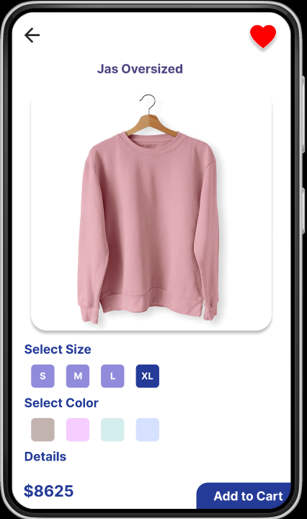

Mockups
For the home page, we learned through usability testing of the medium-ﬁ prototype that users responded well to the simple layout of the homepage. This helped me stick close to the original design.

Slide 21
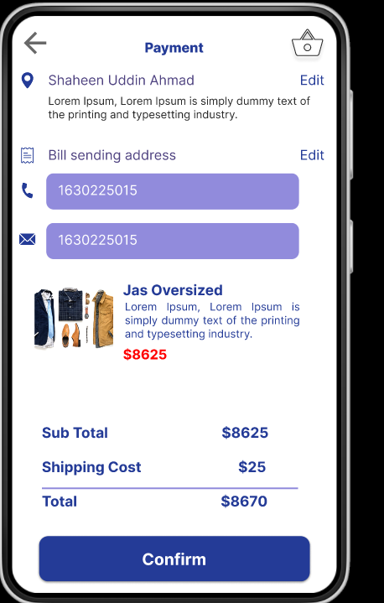
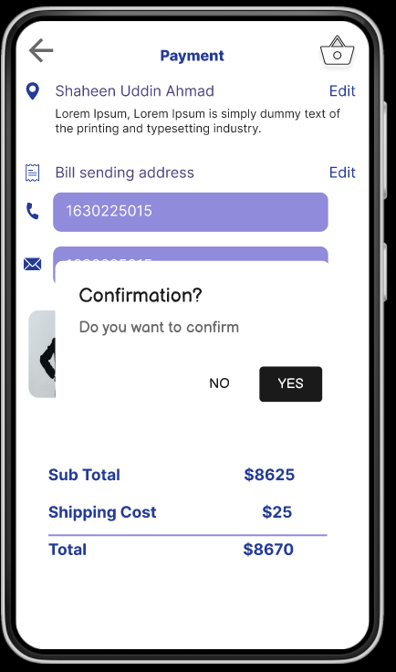
Mockups
Some users had issues with there being no page to make sure the user was sure that they wanted to buy or not. I learned this in the second usability study and had to add a conﬁrmation screen to ensure user conﬁdence in buying process.

Slide 22
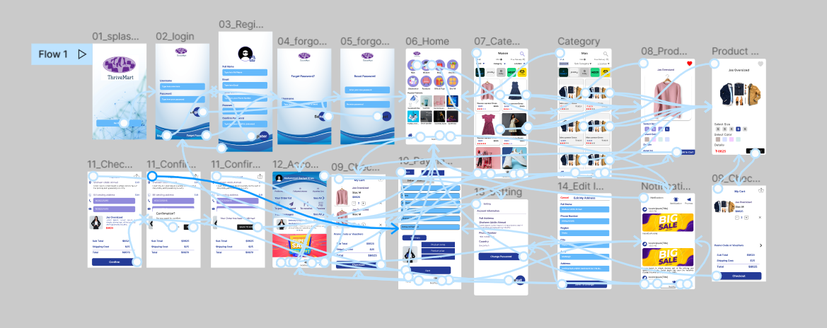
High-FIdelity prototype
User conﬁdence was increased with simple user ﬂow and added conﬁrmation pages
View the
Thrive Mart App
high-ﬁdelity prototype

Slide 23
Accessibility considerations
1 2
3
Screen Reader Compatibility
Color Contrast
Consistent Navigation & Layout
Ensure that the app is compatible with screen readers used by visually impaired users. This involves providing appropriate labels and alt text for images
Choose color schemes that provide sufficient contrast between foreground and background elements. This helps users with visual impairments or color blindness to perceive the content more easily.
Maintain a consistent navigation structure and layout throughout the app. Users with cognitive disabilities rely on consistent design patterns to navigate and understand the content

Slide 24
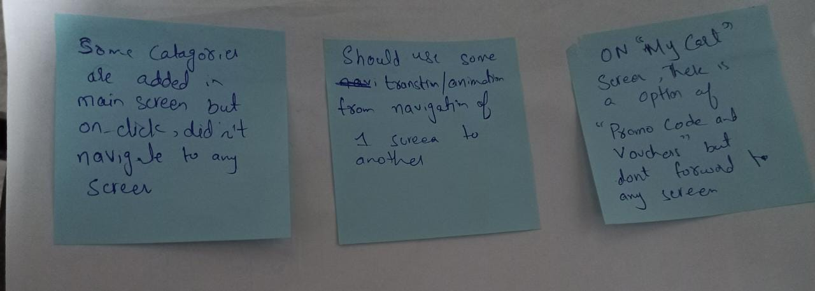
Affinity Diagram

Slide 25
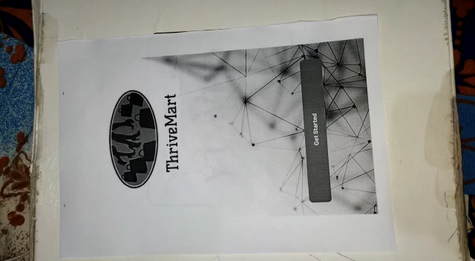
Paper prototype wizard oz

Slide 26


